Slide 1
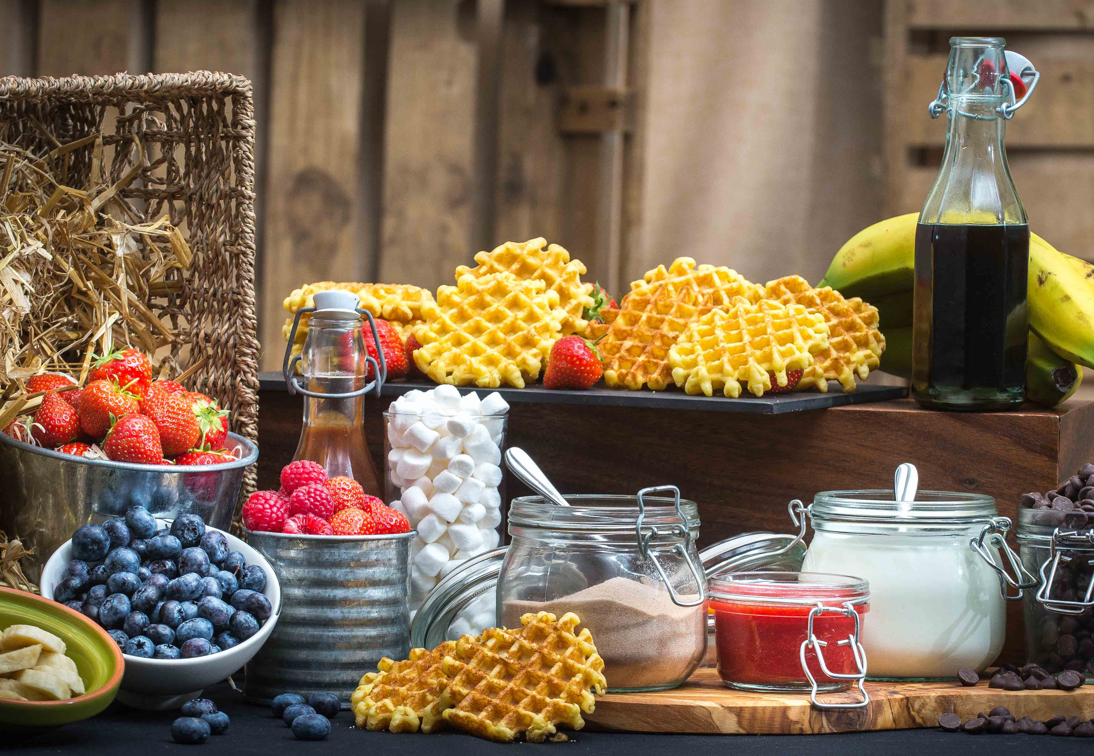
Resource for London (RFL)

Slide 2
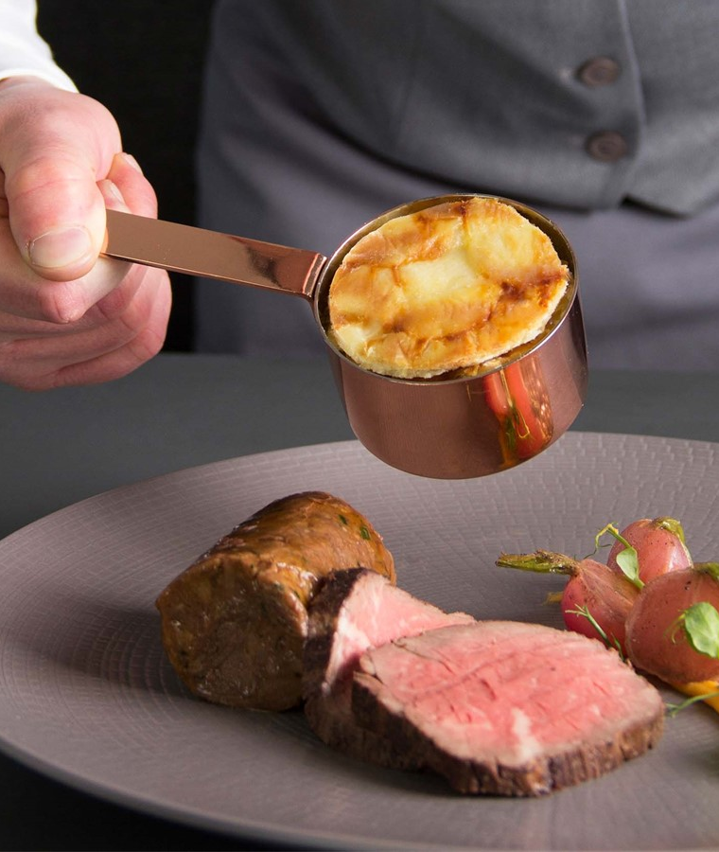
INTRODUCTION
Seasoned is the on-site catering company at Resource for London (RFL) and we are committed to providing food and refreshments for your events in a safe manner for both you and your staff. Some of the options we have considered for mitigating the risks are as follows:
Touch free food options; pre-packed food to avoid contact
All staff trained on Covid-19 safety methods
Enhanced cleaning schedules
The purchase of goods from authorised suppliers with controls in place to reduce the risk of contamination
We are happy to send you the C19 Risk Assessment we undertake when preparing your order.
May we advise you that whilst the menu is correct at the time of printing, there may be a need to change certain sandwich fillings and items as seasons and availability allow.
Our team are always on hand to discuss bespoke catering events you may wish to hold. Do not hesitate in asking us how we can assist you in whichever event it is you have in mind.

Slide 3
BREAKFAST & REFRESHMENTS
DRINKS
Richly roasted Fairtrade Arabica coffee £3.00
Tea, semi-skimmed milk, honey, lemon, Earl Grey, English breakfast, Herbal infusions £3.00
Mixed berry & banana breakfast smoothie per jug serves (6) £2.88
British ‘Life’ water - original & ethical British still & sparkling spring water £3.40
Fruit Juice (per litre) £3.80
Chilled Tap Water (per litre) £1.00
Soda Cans £3.10
DRINKS WITH ACCOMPANIMENTS
Tea Coffee Infusions and Biscuits £4.40
Tea Coffee Biscuits and Fruit Bowl £5.90
Tea Coffee Infusions Chilled Water Orange Juice Danish Pastries and Muffins £8.75
Tea Coffee Infusions and Cake £6.80
FRUIT
Fresh fruit kebabs, passion fruit crème fraîche dip £3.20
Raw energy bliss balls - Apple & cinnamon, Cacao & mint £3.00
Granola, seasonal berries and yoghurt £4.05
Sliced fruit platter £3.85
Piece of fresh fruit £1.75
BREAKFAST
Sausage or Bacon Bap £5.56
Best Back Bacon or Cumberland Sausage with sauces, served on a platter
Breakfast Buffet £13.35
Ham and cheese croissant, smoked salmon and cream cheese bagels, wholemeal muffin
and fruit skewers
Vegetarian and Vegan options available
Exclusive of VAT
(V) Vegetarian (VG) Vegan (GF) Gluten Free (H) Halal
Our food may contain nuts, deratives of nuts or other allergens, if you suffer from an allergy please notify a manager.
We are happy to cater for dietary requirements.

Slide 4
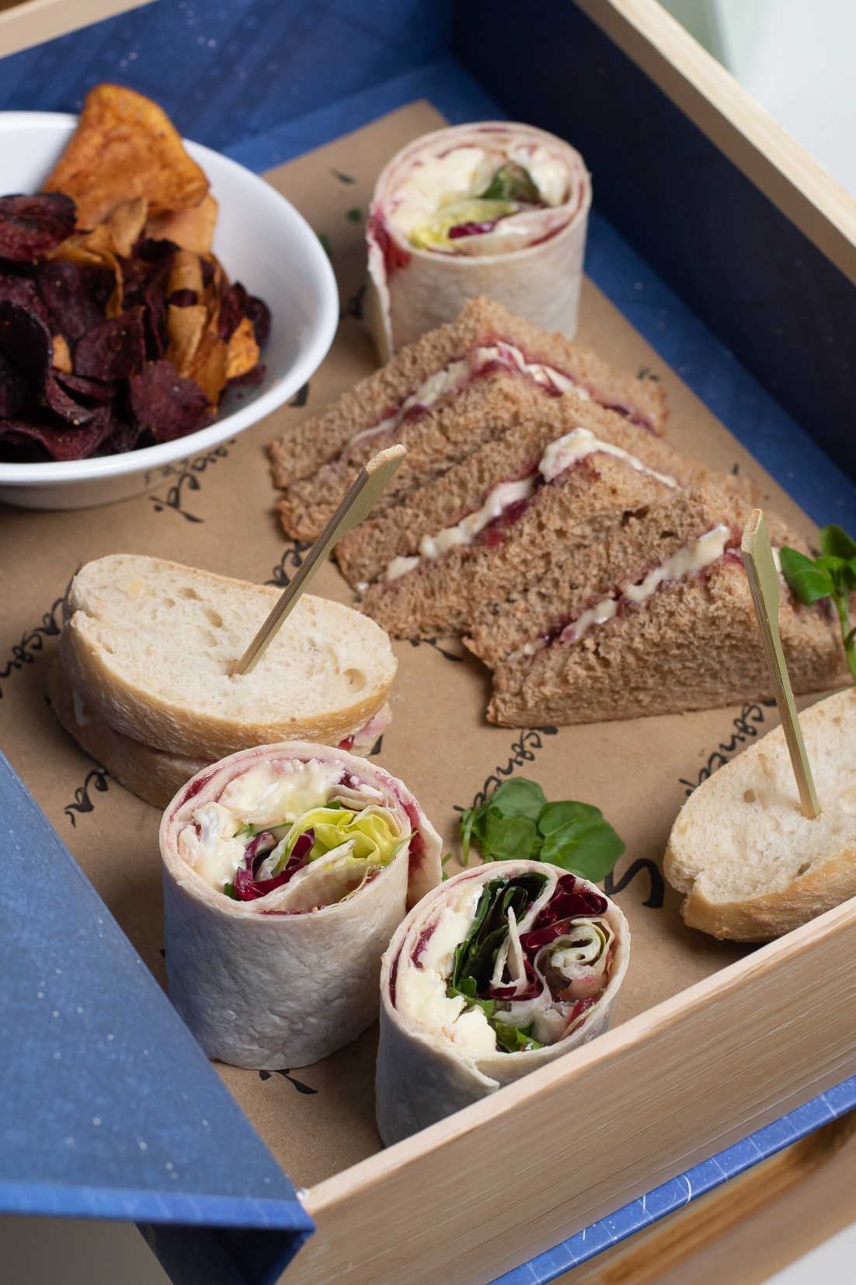
PICNIC IN THE OFFICE
THE SANDWICH LUNCH BAG
An individually packaged baguette sandwich with health bar, crisps and fruit juice £12.45
hand-baked crisps
Ham and tomato
Cheese and pickle (v)
Coronation Chicken (h)
Egg Mayo and cress
Tuna Mayo and cucumber
THE PASTA LUNCH BAG
An individually packed pasta pot with health bar, crisps and fruit juice £12.45
Tuna, dill and sweetcorn pasta pot
Chicken coriander and bacon pasta pot
THE SALAD LUNCH BAG
An individually packed salad box with health bar, crisps and fruit juice £12.45
Honey roast ham and piccalilli
Smoked mackerel and celeriac slaw
Roasted Mediterranean vegetables and line grilled halloumi (v)
THE PLOUGHMAN’S LUNCH £13.85
An individually packed salad box with health bar, crisps and fruit juice
Chef’s quiche with fresh garden salad
Cheese and pickle sausage roll with fresh garden salad
Vegan, Vegetarian and Gluten Free options available
Exclusive of VAT
(V) Vegetarian (VG) Vegan (GF) Gluten Free (H) Halal
Our food may contain nuts, deratives of nuts or other allergens, if you suffer from an allergy please notify a manager. We are happy to cater for dietary requirements.

Slide 5
BENTO BOXES
ROASTED CHICKEN BREAST
Baby gem, bacon lardons, croutons, Caesar dressing £14.50
ROASTED MEDITERRANEAN VEGETABLES
Crisp garden leaves, orzo pasta in pesto dressing , line grilled halloumi (v) £14.50
PEPPERED MACKEREL
Lime and coriander noodles, pickled vegetables, soy dipping sauce £14.50
SMOKED CHICKEN
Vegetable ribbons in lemon oil, edamame bean and garden pea salad (h) £15.20
Vegan and Halal options available
Exclusive of VAT
(V)Vegetarian (VG) Vegan (GF) Gluten Free (H) Halal
Our food may contain nuts, deratives of nuts or other allergens, if you suffer from an allergy please notify a manager. We are happy to cater for dietary requirements.

Slide 6
THE SANDWICH LUNCH
Delicious sandwiches made from our finest sliced bread
with a fruit basket and tortilla chips £12.45
Cheddar cheese and pickle (v)
Roast Ham and mustard
Egg mayonnaise and cress
Tuna mayonnaise and sweetcorn
Chicken and cucumber (h)
Roast turkey and sweet mustard
Vegan and Gluten Free options available
Exclusive of VAT
(V) Vegetarian (VG) Vegan (GF) Gluten Free (H) Halal
Our food may contain nuts, deratives of nuts or other allergens, if you suffer from an allergy please notify a manager. We are happy to cater for dietary requirements.

Slide 7
SANDWICH LUNCH WITH ARTISAN BREADS
Delicious artisan sandwiches served with flap jack and tortilla chips £14.50
Chicken, English mustard mayo served in a demi baguette (h)
Baked English ham, rocket salad served in multi grain loaf
Tuna flakes, sweetcorn, dill mayonnaise served in a tortilla
Hummus, shredded red peppers, falafel served in ciabatta (vg)
Cajun mixed beans, iceberg lettuce, lime dressing served in a tortilla (vg)
Mature Cheddar cheese, farmhouse tomato relish served in rosemary scented focaccia (v)
Gluten free options available
Exclusive of VAT
(V) Vegetarian (VG) Vegan (GF) Gluten Free (H) Halal
Our food may contain nuts, deratives of nuts or other allergens, if you suffer from an allergy please notify a manager. We are happy to cater for dietary requirements.

Slide 8
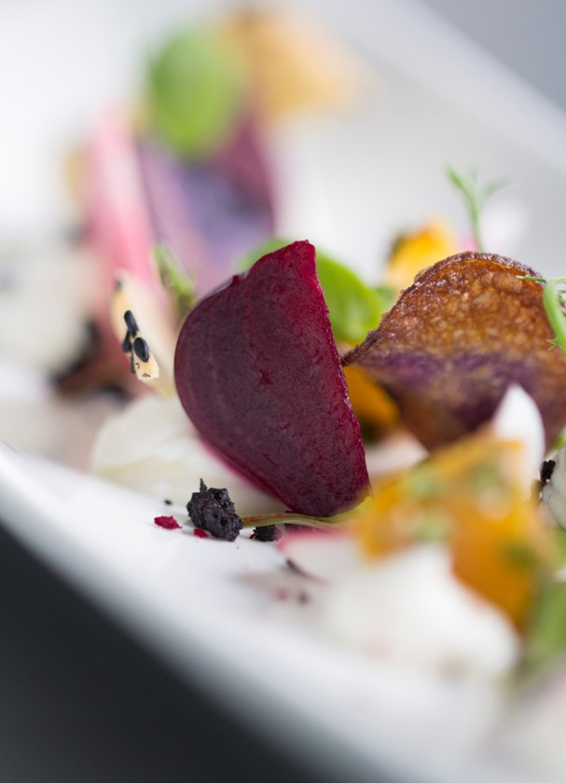
VEGETARIAN/VEGAN MENU
VEGETARIAN SANDWICHES AND LIGHT BITES £21.85
Compressed cucumber and minted cream cheese served in white loaf (v)
Chickpea, iceberg lettuce and harissa dressing served in a tortilla wrap (v)
Mature cheddar cheese, sun-dried tomatoes served in wholemeal bread (v)
Light Bites:
Baby plum tomatoes, black olive and Mozzarella skewers (v)
Mini vegetable tartlets (v)
Mixed Chef’s salad (v)
Chocolate brownies (v)
Sea salt popcorn (v)
VEGAN SANDWICHES AND LIGHT BITES £21.85
Roasted red pepper, hummus and cucumber ribbons served in ciabatta (vg)
Vegan cheese, cucumber and tomato chutney served in a wholemeal baguette (vg)
Hummus, grated carrot and falafel served in a tortilla wrap (vg)
Light Bites:
Selection of falafel with dips (1 per person) (vg)
Roast vegetable skewers (1 per person) (vg)
Fruit platter (vg)
Vegan crisps (vg)
Slice of cake (vg)
Gluten Free options available
Exclusive of VAT
Our food may contain nuts, deratives of nuts or other allergens, if you suffer from an allergy please notify a manager. We are happy to cater for dietary requirements.

Slide 9
SANDWICHES AND LIGHT BITES
SELECTION OF ARTISAN FILLED SANDWICHES WITH LIGHT BITES £21.85
Baked ham and Cheddar cheese ploughman’s served in a demi baguette
Salami, mayonnaise, sliced gherkin, wholegrain mustard and seasonal leaves on multi grain bread
Peppered mackerel, lemon mayonnaise and baby gem served in a tortilla
Roast turkey, apricot jam, bacon and baby spinach in a ciabatta
Beetroot, hummus, cucumber and mixed leaves on white bread (vg)
Egg mayonnaise and mustard cress in rosemary scented focaccia
Light Bites:
Marinated BBQ Halal chicken breast spears (h) – 1 per person
Vegetable crudities and dips (vg) – 4 pieces per person
Tortilla crisps
Seasonal fruit platter (vg)– 2 pieces per person
A slice of cake (v)– 1 piece per person
Gluten Free options available
Exclusive of VAT
(V) Vegetarian (VG) Vegan (GF) Gluten Free (H) Halal
Our food may contain nuts, deratives of nuts or other allergens, if you suffer from an allergy please notify a manager. We are happy to cater for dietary requirements.

Slide 10
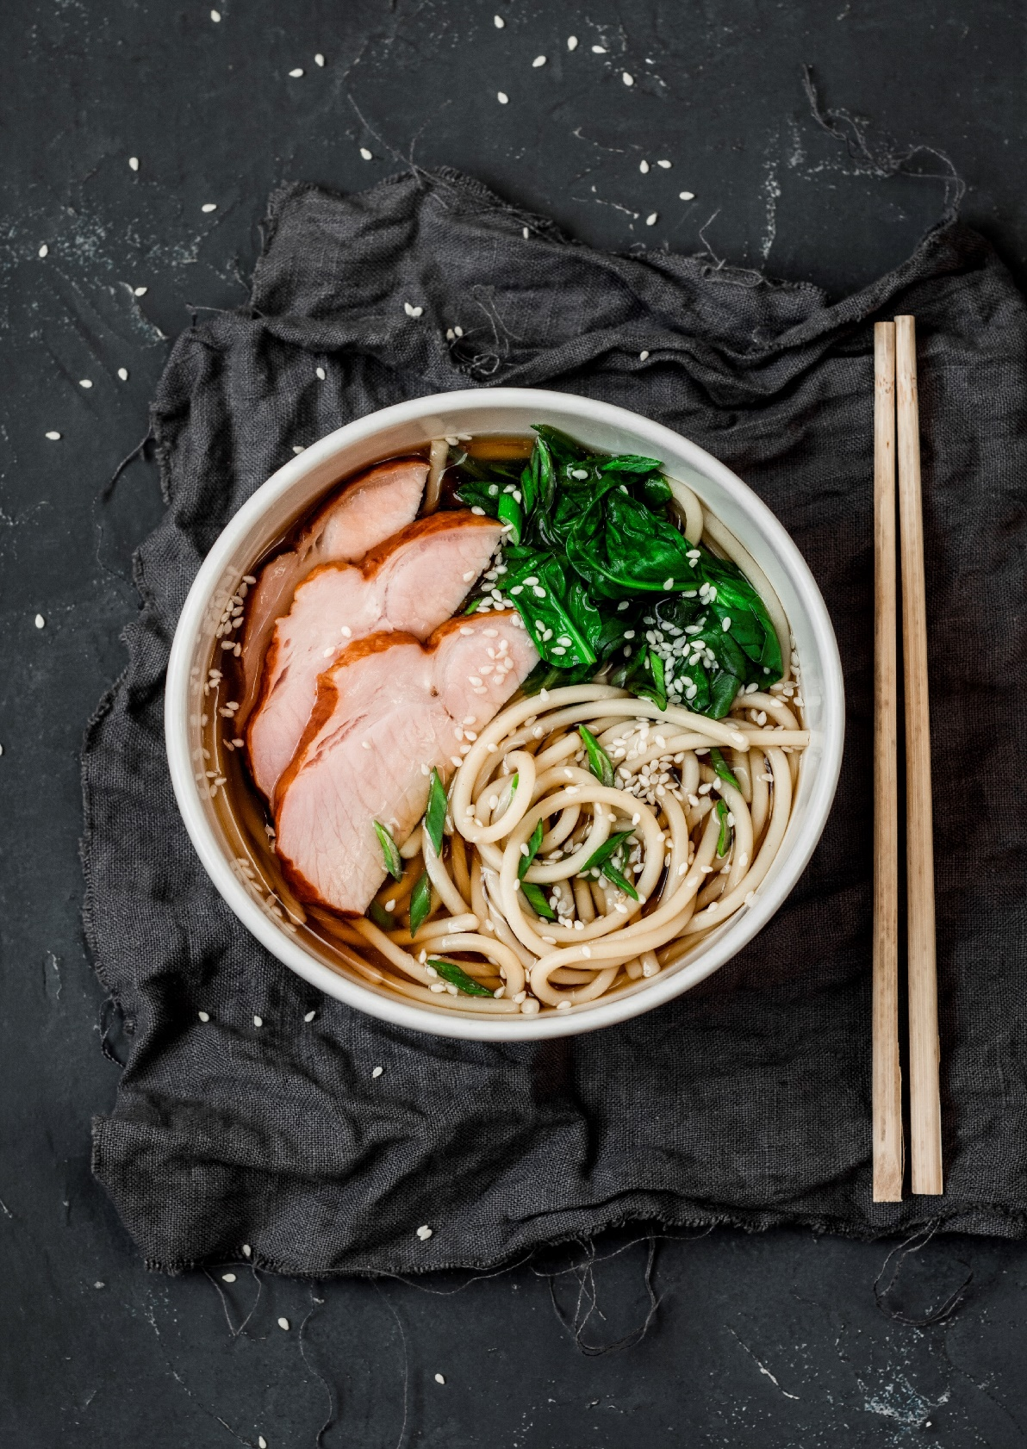
BREADLESS PACKAGE
This package includes a selection of three delicious protein salads, smoothies and raw nuts £20.25
THREE SALADS
Rainbow roasted beetroots with goat’s cheese crumble, torn mint leaves and roasted red pepper (v)
Mackerel, cucumber, radish, black pepper, edamame beans and tomatoes with basil and lemon oil
Poached chicken with kale, dried cranberry, cracked wheat salad and toasted walnuts (h)
All salads are served with a side dressing
Add protein to any of the above salads
Lemon thyme chicken - £3.45 per person
Roasted salmon - £4.60 per person
Smoothie Shot option:
Guava, carrot and melon
Kiwi fruit, spinach, cucumber and lime
Undressed raw mixed fruit and nuts
Vegan option available
Exclusive of VAT
(V) Vegetarian (VG) Vegan (GF) Gluten Free (H) Halal
Our food may contain nuts, deratives of nuts or other allergens, if you suffer from an allergy please notify a manager.
We are hapy to cater for dietary requirements.

Slide 11
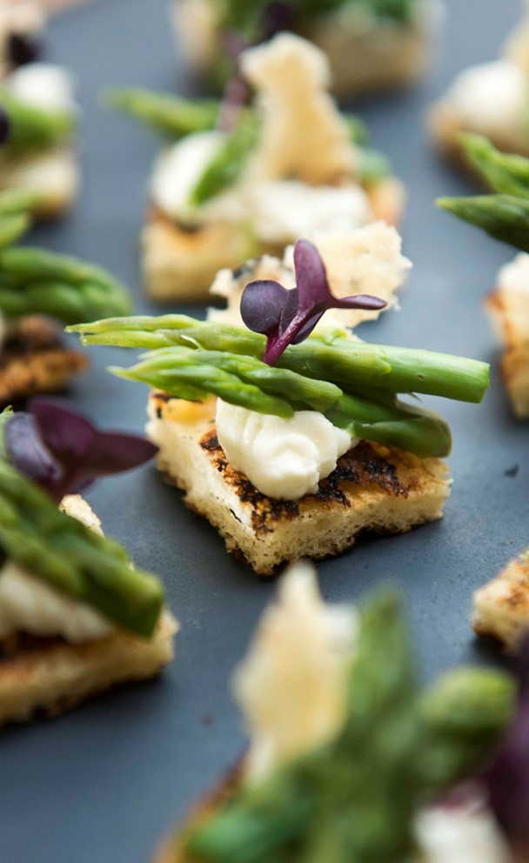
FINGER FOOD
THE FINGER BUFFET £23.60
PLEASE CHOOSE 7 ITEMS
MEAT
BBQ Chicken skewers with dipping sauce (h)
Duck spring rolls with dipping sauce
Mini filled Yorkshire pudding
Mini pork pies
Mini sausage roll
Selection of quiche tarts
FISH
Mini fish cakes with tartare sauce
Mini smoked salmon bagels
Lemon sole goujon
Mini fish and mushy pea rosti
VEGETARIAN
Little pizza bites
Vegetable samosas
Selection of quiche tarts
Vegetable spring rolls
Falafel with yogurt and mint dip
SWEET
Mini assorted fruit tarts
Selection of macaroons
Mini cheesecake selection
Mini brownie bites
Fresh fruit skewers
Chocolate dipped strawberries
Vegan and Gluten Free Options available
Exclusive of VAT
(V) Vegetarian (VG) Vegan (GF) Gluten Free (H) Halal
Our food may contain nuts, deratives of nuts or other allergens, if you suffer from an allergy please notify a manager. We are happy to cater for dietary requirements.

Slide 12
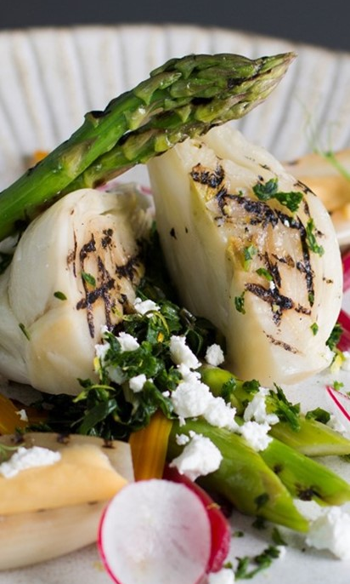
HOT BUFFET
One main course plus one main vegetarian course £33.95
Minimum of 10 people, 1 main item, 1 vegetable option,
Chef’s salad, breads and dessert
Below is a sample selection, but Chef’s choice will be provided on the day
FROM THE FARM
Beef lasagne
Fragrant Thai green chicken curry with roasted peanuts and coriander (h)
FROM THE SEA
Teriyaki salmon pieces on a bed of bean shoots, pak choi and plum dressing
Pan –fried cod fillet, lemon zest and dill
FROM THE FIELD
Sweet potato and lentil spiced curry in coconut milk (vg)
Macaroni, Cheddar cheese and tomato bake (v)
FROM THE VEGETABLE PATCH
Steamed new potatoes (vg)
Herbed couscous (vg)
Vegetable medley (vg)
DESSERT
Sticky toffee pudding with toffee sauce (v)
Triple chocolate mousse, popping candy and chocolate shards (v)
Seasonal fruit bowl (vg)
Gluten Free option available
Exclusive of VAT
(V) Vegetarian (VG) Vegan (GF) Gluten Free (H) Halal
Our food may contain nuts, deratives of nuts or other allergens, if you suffer from an allergy please notify a manager. We are happy to cater for dietary requirements.

Slide 13
FORCE MAJEURE
1. Seasoned shall not be liable for any delay or for non-performance of its obligations under this agreement for as long as this is due to a Force Majeure event.
2. Force Majeure event means "Force Majeure Event" means any event or circumstance which is beyond the reasonable control of the affected party and which is not attributable to any wilful act, neglect, or failure to take reasonable preventative action by the affected party and includes (insofar as it is beyond such control and not so attributable) an event which falls into one or more of the following categories:
(a) lock out, work stoppages, slowdowns or any other industrial or labour dispute (excluding, in all cases, any such circumstances to the extent such circumstances involves the employees, agents, subcontractors and/or other suppliers of the affected party);
(b) act of God, fire, explosion, collapse of buildings, flood, storm, earthquake, extreme adverse weather conditions;
(c) war, hostilities, military action, riot, civil commotion, terrorism;
(d) epidemic or pandemic;
(e) nuclear, chemical, or biological contamination or sonic boom;
(f) explosion or malicious damage;
(g) any action taken by a government or public authority, including imposing a lockdown, an embargo, export or import restriction, quota or other restriction or prohibition, or the failure to grant any necessary licence or consent.
3. Where Seasoned is delayed or prevented from performing its obligations under this agreement by a Force Majeure Event, then Seasoned shall as soon as reasonably possible inform the other party of the Force Majeure Event and of its impact. Seasoned shall use best endeavours to mitigate the effect of the Force Majeure Event.

Slide 14
PAYMENT
TERMS & CONDITIONS
Seasoned Venues Ltd offers no credit accounts at Resource for London
All events must be paid seven days prior your event for your booking to commence.
Please contact officemanager@beseasoned.co.uk for full details.
All prices are quoted excluding VAT and the statutory rate is charged at the time of invoice.
Prepayment will need to be received at least Seven days before the event date .
If Seasoned Venues Ltd has not received full payment, the order will not be honoured and you will be liable for full cancellation charges.
Seasoned Venues Ltd reserves the right to charge two percent above the RBS base rate on all overdue invoices.
We accept all major credit cards except American Express with a 4% charge for corporate cards
We will also accept cleared funds via BACS.
All information will be sent prior the booking
All prices quoted herein are valid for two weeks from contract date.
Orders need to be emailed to officemanager@beseasoned.co.uk ten days (Monday – Friday), prior to required event date.
Due to the presence of wheat and nuts and gluten in our kitchen, we cannot guarantee the absence of contamination in any of our dishes. Therefore, if there are any allergens, please be sure that a disclosure is arranged.
If an order is made with less than 72 hours’ notice, there is a possibility for the exact product to be sold and an alternative will be made to ensure the goods to be delivered. Please be sure to email officemanager@beseasoned.co.uk to confirm your selection and if an alternative is arranged.
Claims for shortages, loss and damages should be made at the time of delivery but in any event no later than 24 hours’ of delivery for investigation.
Last minute requests/amendments will be dealt with as effectively as possible.
Seasoned Venues Ltd will accommodate the best we can, although it may not always be possible due to the nature and constraints of our business.
You must give 5 working days’ notice for cancellations. We will only accept written cancellation notices. Failure to do so will result in the full price being charged.
Our office hours are 8.00am - 4.30pm Monday to Friday. Please contact us between these times should you wish to speak directly to a member of our team.
Our company policy states that all hot food needs to be consumed within two hours of bring presented.
Cold food is to be consumed within four hours (if not refrigerated) once delivered to the meeting room.
Seasoned Venues Ltd will not be liable for food consumed after this time.
Seasoned Venues Ltd are the approved caterer for Resource for London to comply with the Food Safety Act of 1990 all catering has to be provided by us, this act will be negated if snacks or take away food is brought in from other sources.
Seasoned Venues Ltd will not be liable for any loss due to any circumstances which include, but not exclusively, breakdown of machinery, failure of supply of electricity or other utilities, leakage of water, fire, flood, explosion, strike or labour dispute, external road or building works, Government restrictions, Force Majeure, act of terrorism or any circumstances outside the control of Seasoned Venues Ltd which may result in it being unable to perform its obligations.
No liability is accepted for loss, damage or consequential loss, except to the extent required by law caused by Seasoned Venues Ltd failing to perform its obligations (whether that failure is due to negligence on the part of Seasoned Venues Ltd, its officers, employees or due to other causes), but nothing herein shall exclude Seasoned Venues Ltd obligation to pay compensation for death or personal injury as required by law.
Any feedback must be received by Seasoned Venues Ltd in writing not more than 48 working hours following delivery of the order to officemanager@beseasoned.co.uk

Slide 15
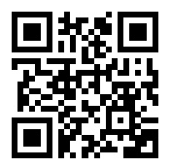
www.beseasoned.co.uk

